Slide 1
SNLP-MinProj Group name : SmartBV^2
Burhan Otour
Vineet Vasishta Eranki
Sandeep Varma Ganaraju
GitHub repo: https://github.com/BurhanOtour/SNLP-MinProj.git

Slide 2
Corpus creation
Data Set : New York Times 2013
Number of Articles: Approx. 10,000 Articles
Source Format: JSON
After cleaning of JSON tags , the file is converted to plain text.

Slide 3
Corpus Analysis
1. Named Entity Extraction
FOX (Federated knOwledge eXtraction framework)
provides users with accurately disambiguated and linked named entities in several RDF serialization formats
Fox implements below 4 NER Tools:
OpenNLPEN
StanfordEN
IllinoisExtendedEN
BalieEN
Stanford NER Model used is
3 class: Location, Person, Organization

Slide 4
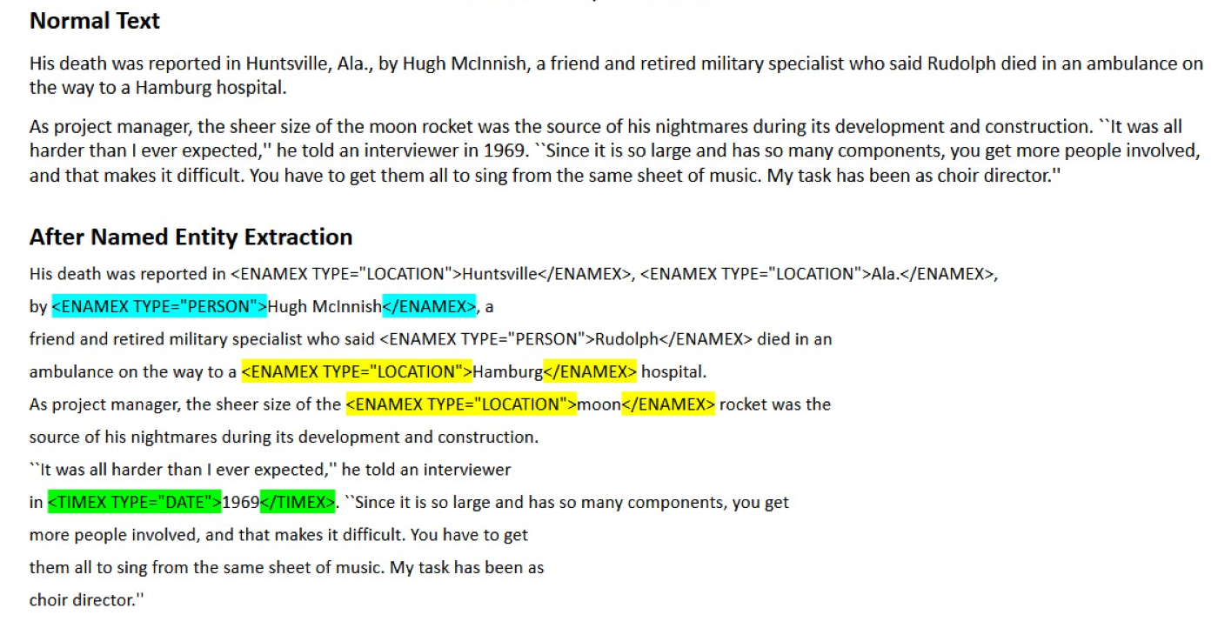
NER 7 class: Location, Person, Organization, Money, Percent, Date, Time

Slide 5
2.Entity Disambiguation
FOX also disambiguates and links named entities against DBpedia by relying on the AGDISTIS framework
Link entities against every Linked Data knowledge base.
3.Relation Extraction
find relations between two entities.
Used for extracting relation triples from Text.
triple is a data entity composed of subject-predicate-object
Example : [Leipzig University] located in [Leipzig]
RDF triples are stored in Turtle document in .TTL file extension

Slide 6

Fact Checking and Benchmarking
The truth value τ (e) ∈ [ 0, 1 ] of a new statement e = (s, p, o) is derived from a transitive closure of the Wikipedia Knowledge Graph [1]. More specifically, the truth value is obtained via a path evaluation function:
Based on this true statements are assigned higher truth values than false ones with probability.
[1] Computational Fact Checking from Knowledge Networks, Giovanni Luca Ciampaglia ,
Prashant Shiralkar, Luis M. Rocha, Johan Bollen,Filippo Menczer,Alessandro Flammini

